Slide 1
Prosser River Foreshore
Proposal to address the future use of this Crown Land Tenure.
To address the Natural and Cultural Values in accordance with the Crown Land Act.
To address the protection of the EPBC listed vulnerable Fairy terns and other vulnerable resident shorebirds.
To address the issues of public amenity and usage in this township of ORFORD.
To address the silting up of the lagoon and attendant problems

Slide 2
The Prosser River Foreshore and Sand Spit

Slide 3
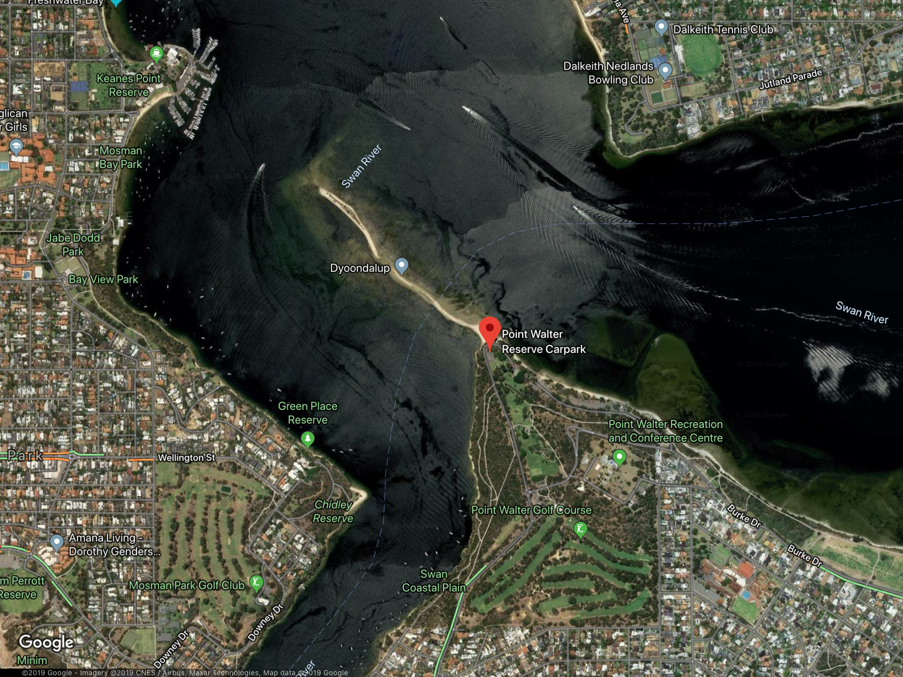
The Point Walter Site: Perth/Fremantle Conurbation
Notes:
The Point Walter Site: Perth/Fremantle Conurbation

Slide 4
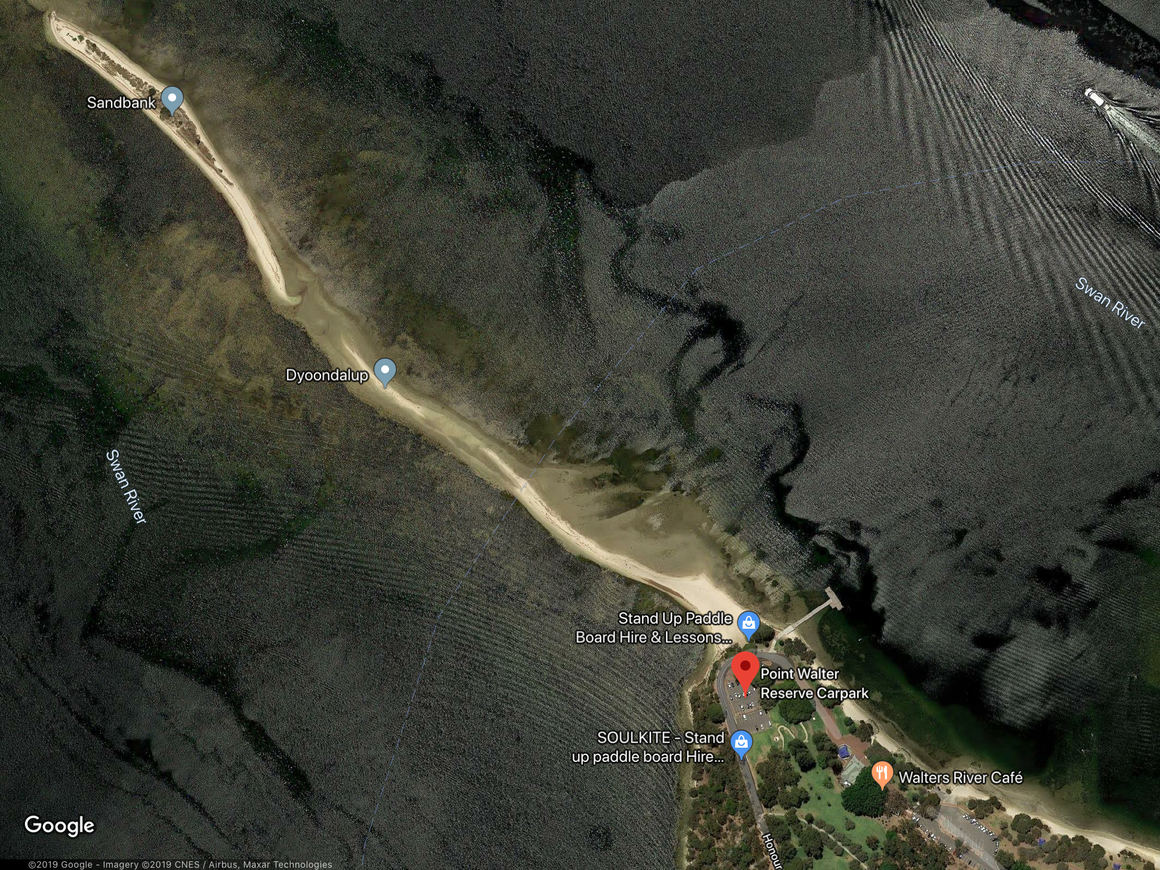
Notes:
When researching this proposal, I found that Australian experts had already managed a similar situation in Western Australia.
The City of Melville in the Perth Fremantle conurbation had a sand spit in the middle of a highly urbanised area which was frequented by fairy terns for night roosting but had not been successful as a breeding area. Three years ago under he management of Dr Nick Dunlop, Murdoch University, Adj Senior Lecturer Environmental Science and Policy Coordinator Conservation Council, and PhD Candidate Claire Greenwell, both very experienced in fairy tern and shorebird management, a program was started with the support of local council, to address the possible causes of lack of breeding success
When researching this proposal, I found that Australian experts had already managed a similar situation in Western Australia. The City of Melville in the Perth/Fremantle conurbation had a sand spit in the middle of a highly urbanised area which was frequented by fairy terns for night roosting but had not been successful as a breeding area. Over the 2016/17 summer, the City of Melville installed a temporary fence at the end of the sandbar in an attempt to reduce disturbance to nesting Fairy Terns. This was the first year that breeding efforts were successful. Two years ago PhD Candidate Claire Greenwell, under the supervision of Dr Nic Dunlop, Murdoch University, Adj Senior Lecturer Environmental Science and Citizen Science Coordinator Conservation Council, WA, both very experienced in fairy tern and shorebird management, commenced a research program with the support of local council, to address learn more about the local Fairy Tern population. Through this research, awareness of Fairy Terns and the threats they face during the breeding season have increased within the community. Community support and advocacy has been an essential component in the success of this site as a nesting area for Fairy Terns.

Slide 5
Similar multi user situation
2016/17 temporary fencing installed
First successful breeding season
Community education and support
Notes:
Similar multi user situation
2016/17 temporary fencing installed
First successful breeding season
Community education and support

Slide 6
Proposed management plan for Orford Sand Spit
That the entire area from the southern end of the Raspin’s Beach Conservation area to the fence line at the northern sand bag groyne and including Radar Beach be a No Dog Zone at all times.
That the sand spit becomes an total exclusion zone for the public for the breeding season.
That Radar Beach is open to the public with a safe soft entry at all times and that the parking and access be improved to reduce dust (possibly with concrete grids with grass).
That hides, if included in the plan, be located in the area at the north end of the lagoon inside the fenced area.
That the fencing along Radar Beach and on the west side of the channel be removed.
That the signs be carefully assessed so that the curious are not encouraged to go looking for nestlings or eggs.
Notes:
It is this management plan that I propose for the Orford Sand Spit.
That the entire area from the southern end of the Raspin’s Beach Conservation area to the fence line at the norther sand bag groyne and to Radar Beach be a No Dog Zone at all times.
That the sand spit becomes an total exclusion zone for the breeding season.
The Radar Beach is open to the public with a safe soft entry at all times.
That hides be located in the area at the north end of the fenced area.
That only the fencing along Radar Beach and on the west side of the channel be removed.

Slide 7
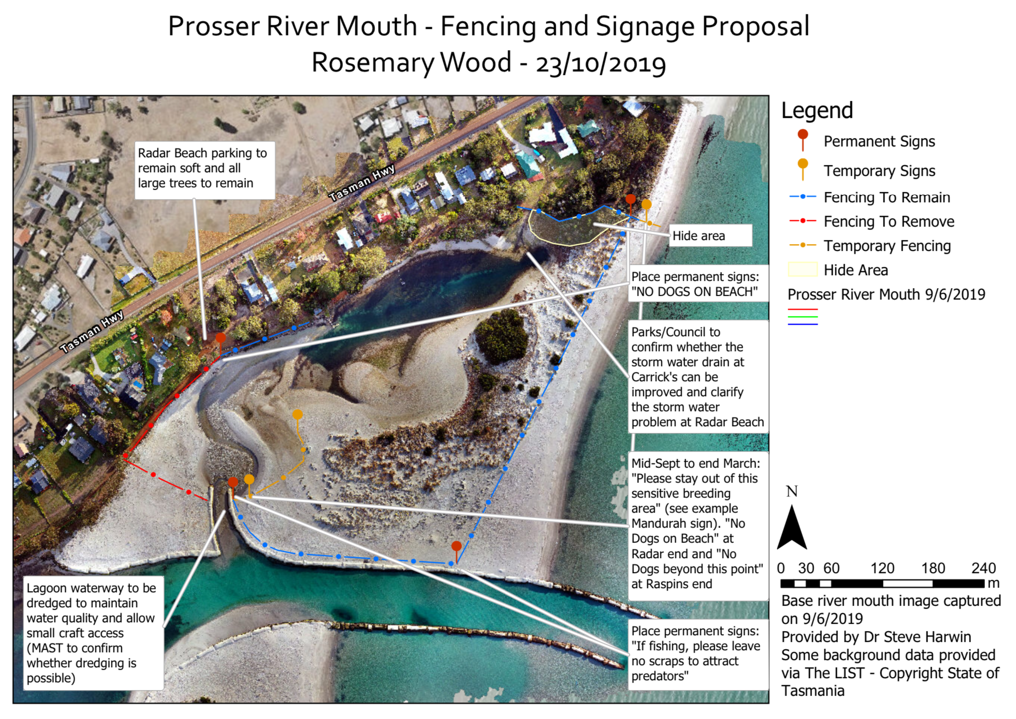
Notes:
The Point Walter program has been successful and fairy terns have been fledged from the site over the past 3 years, since the following steps were taken.
Education by signage.
Involving and actively promoting the locals as ‘wardens’
Temporary barriers with temporary informative signage erected 2 weeks before the birds arrive and removed when the breeding season ends. This will also protect the resident shorebirds hooded plovers, red-capped plovers and pied oyster catchers.
Encouraging people to stay away from the nesting sites even if they are using the surrounds.
During the winter the site is maintained by removing predators and prey that brings in predators. Rabbits encourage dogs and cats to hunt on site.
Removing vegetation like marram grass and boobialla that make the site unsuitable for fairy terns as they choose open lightly or un-vegetated sites.
As accretion extends the sand bar to the east the fairy terns are likely to move out of the present fenced area and/or over to Millington’s Conservation area, unless the site is groomed and possibly sandbagged to avoid inundation by tidal and storm surges. This impact increases as the sea bed level rises with accretion.

Slide 8
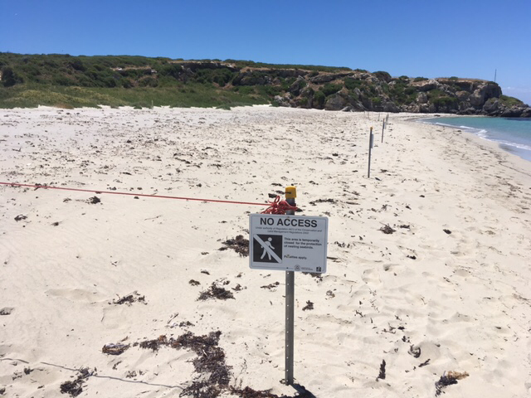
Temporary signage
Notes:
Temporary signage

Slide 9
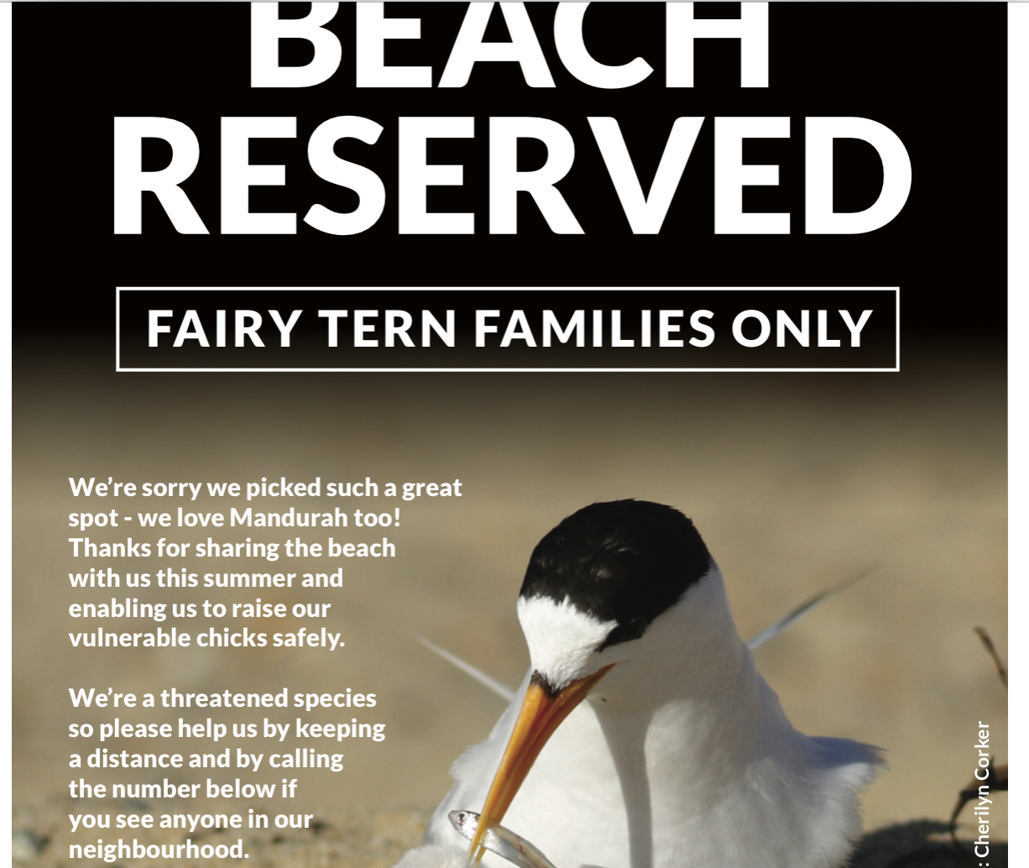

Slide 11
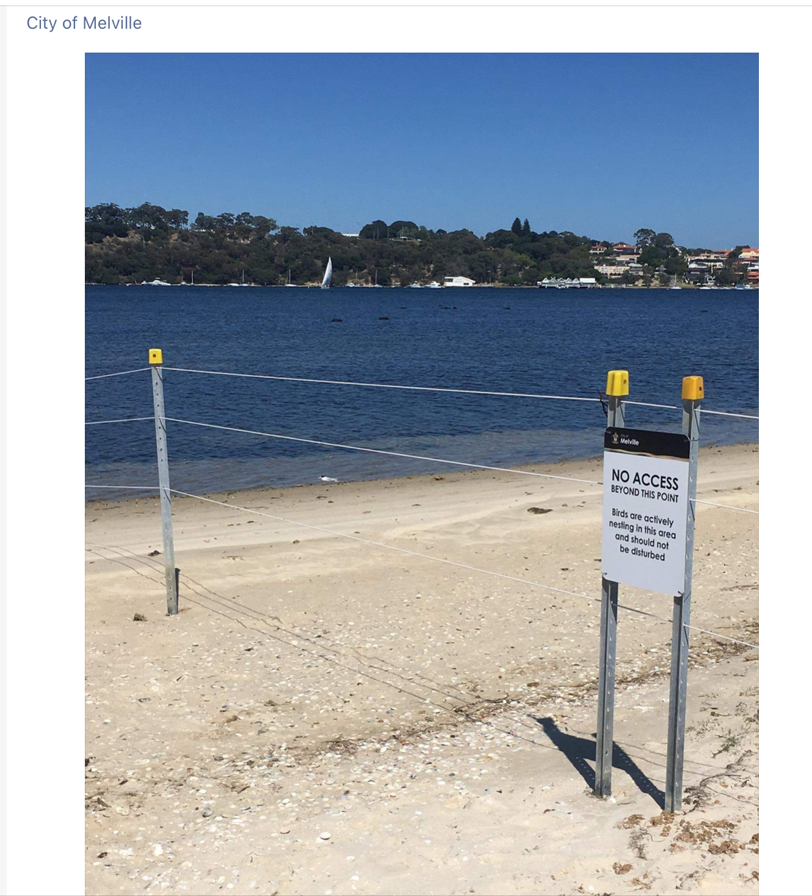

Slide 13
Lagoon
Increased silting since stabilisation
Changing nature of lagoon
Decreasing value as a foraging area esp for fairy terns
Notes:
This brings me to the issue of the lagoon.
In 2002 Parks undertook to keep the lagoon flushed after the cutting of a channel across the Millington reserve and thus creating the lagoon/backwater.
The stormwater drain at the northern end was expected to create a stench problem. It has.
This has been exacerbated as a result of the stabilisation by the geotech bags and the small side channel into the lagoon which has become silted up, as has the lagoon. The appearance of ducks and swans in the lagoon is testament to the changed nature of the lagoon which is now becoming stagnant and is no longer optimal as a foraging area for fairy terns.
My husband and I and Libby Brown made a total of 17 x 10min observations from 15-17th Dec, 2018 from two sites. One on the open beach about 100-150 metres from the nesting area and the other at the Saunders jetty.
During simultaneous 10 minute site observations over a total of 3 hours over 3 days under different tidal conditions and times of day we observed about 150 foraging trips from the open sea location with the birds returning to the nest site and on the lagoon side only 3 dives were observed and only one was successful.
The flow into the lagoon is now very slow and silting has been rapid. The sea grass has been covered which decreases the nursery grounds for fish and increases the sulphite build up.
North of the sandbars that have developed in the lagoon the water is virtually stagnant and there is minimum visibility.
Fairy terns need 1metre of visibility into blue water to catch the small fish they need. As a result, they are fishing in the channel and out to sea. They rest on the sandbags and seem unperturbed by passing boats.
The hooded plovers, red-capped plovers and oyster catchers feed on molluscs and small vertebrates along the strand line in the debris/seaweed on tidal flats
The invasion by ducks and swans is testament to the changing nature of the lagoon and indicates that this water body is no longer optimum for fairy terns. Oyster catchers, hooded and red-capped plovers are tidal flat foragers and when the entrance to the lagoon becomes closed by silting these residents shore birds will also be adversely affected.
Not flushing the lagoon has had adverse implications for the birds and for the public as the sulphites build up and the seaweed, sea spurge, algae and waste coming down the storm water drain rots and causing a stench.

Slide 14
The management of the sand spit will require
Placing of permanent robust No Dogs signs, with accompanying regulations, possible fines and a contact phone number, at the Raspins end of the spit and at the Radar Park access point
Siting of a temporary fence at the Raspins Beach end with accompanying signage(possibly also at the end of the geotech bags on the northern groyne: No access beyond this point (this to be temporary and temporal)
Removal of fencing on the west side of the river and lagoon and consideration given to clear signage that is not ambiguous or encouraging to the curious to enter the breeding area
The regular flushing of the lagoon
The management of invasive plant species i.e marram grass and boobialla which will create an unsuitable nesting area for fairy terns now that the spit has been stabilised, forcing them to choose other sites
The management of predators, and prey for predators, in the winter season esp rabbits which attract dogs and cats
Signage re fishers and litter.
Notes:
The management of the sand spit will require the following actions:
1. Placing of permanent robust No Dogs signs, with accompanying regulations and possible fines and a contact ph number, at the Raspins end of the spit and at the Radar Park access point
2. Siting of a temporary fence at the Raspins Beach end with accompanying signage(possibly also at the end of the geotech bags on the northern groyne: No access beyond this point (this to be temporary and temporal)
3. Removal of fencing on the west side of the river and lagoon and consideration given to clear signage that is not ambiguous or encouraging to the curious to enter the breeding area
4. The regular flushing of the lagoon
5. The management of invasive plant species i.e marram grass and boobialla which will create an unsuitable nesting area for fairy terns now that the spit has been stabilised, forcing them to choose other sites
6. The management of predators, and prey for predators. in the winter season esp rabbits which attract dogs and cats
7. Signage re fishers and litter.

Slide 15
Other issues
Boat ramp: location, parking, congestion
Dredging
Opening of the lagoon
Erosion of Raspins Beach
Notes:
Other issues that will need to be considered:
The boat ramp location, the boat trailer and parking congestion is to be addressed by Peter Hopkins.and MaST. This will also follow due process including public consultation.
The dredging of the channel and addressing the associated safety issues will also be addressed by MaST along with safe swimming concerns.
The possible opening of the lagoon at the old mouth once a year should be considered to assist with flushing and to create a water barrier on to the sand spit.
The dredging and keeping open the side channel is essential to maintain the integrity of the lagoon and address the problems raised earlier.
The erosion and replenishing of Raspin’s Beach could be addressed by moving sand from the old river mouth in winter.
This is an issue that will require consultation and consideration of the options suggested by DFA Steane and DN Foster (1993) and more recently by C Sharples.
References:
Creating new habitat (environment.NSW.gov.au)
Narvis.co.au
Dunlop JN (2015)
Conservation and Assessment of beach nesting and migratory shorebirds in Tasmania. Dr Sally Bryant DIPWE 2002
DPIPWE
Environment NSW
DFA Steane and DN Foster (1993)
Dr Nic Dunlop, Claire Greenwell and Mark Holdsworth, three highly regarded research and management scientists in this area, are happy to have open conversation with all parties to discuss research undertaken in management programs.

Slide 16
References
Creating new habitat (environment.NSW.gov.au)
Narvis.co.au
Dunlop JN (2015)
Conservation and Assessment of beach nesting and migratory shorebirds in Tasmania. Dr Sally Bryant DIPWE 2002
DPIPWE
Environment NSW
DFA Steane and DN Foster (1993)
Dunlop, J. N. (2018). ‘Fairy Tern (Sternula nereis) conservation in south-western Australia’ 2nd ed. (Conservation Council of Western Australia: Perth, Western Australia.) Available at: https://d3n8a8pro7vhmx.cloudfront.net/ccwa/pages/188/attachments/original/1531104929/CONS_192_Tern_manual_complete_updated.pdf?1531104929
Dunlop, J. N. (2016). Local Fairy Tern conservation strategy for the south west coastal region. Perth, Western Australia. Available at: http://www.ccwa.org.au/fairyterns

